Slide 1

Green_Egypt

Slide 2
- In this Presentation , we will talk about Green Egypt System in 4 main Sections :
System main idea .✔`
System Features .✔`
System Work Flow Diagram .
Application UI . ✔`

Slide 3
1/ Green Egypt System main idea : - our main idea is Making recycling process easier , user can benefits from the recycling by taking cash “as points ” , also help the Environment to stay green 🍀.
We can achieve this idea by creating simple and easy system that any one can deal with .
this simple system is represented in :
Simple Recycling Machine .
Simple Application .

Slide 4
2/ System Features :
Help Recycling Companies in Recycling garbage by collecting and splitting it in our Machines .
User can take points depending the garbage that he/she throw .
Machine inform workers that it full .

Slide 5
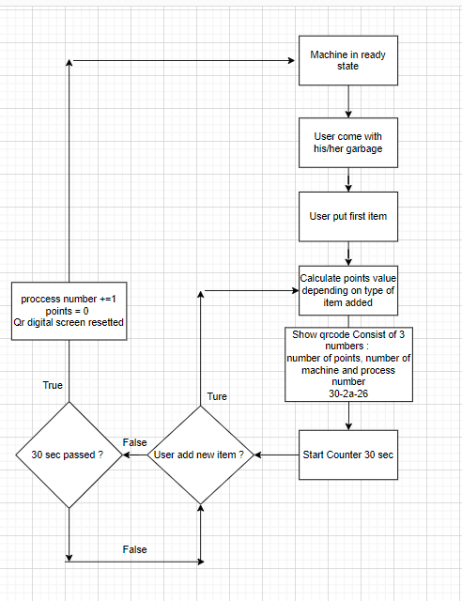
3. System work flow Diagram :
- This diagram show how system work from user side .

Slide 6
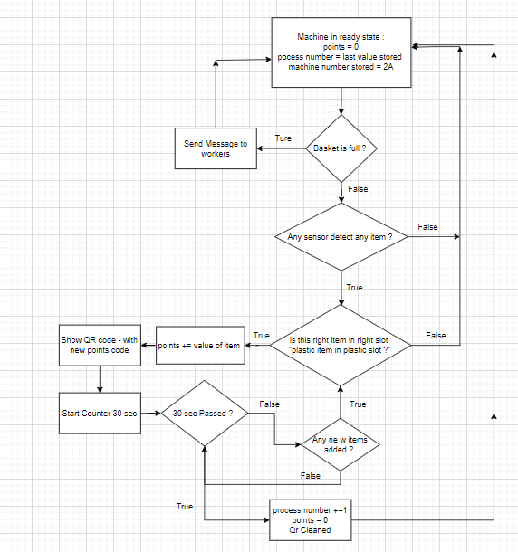
3. System work flow Diagram :
- This diagram show how system work from machine side .

Slide 7
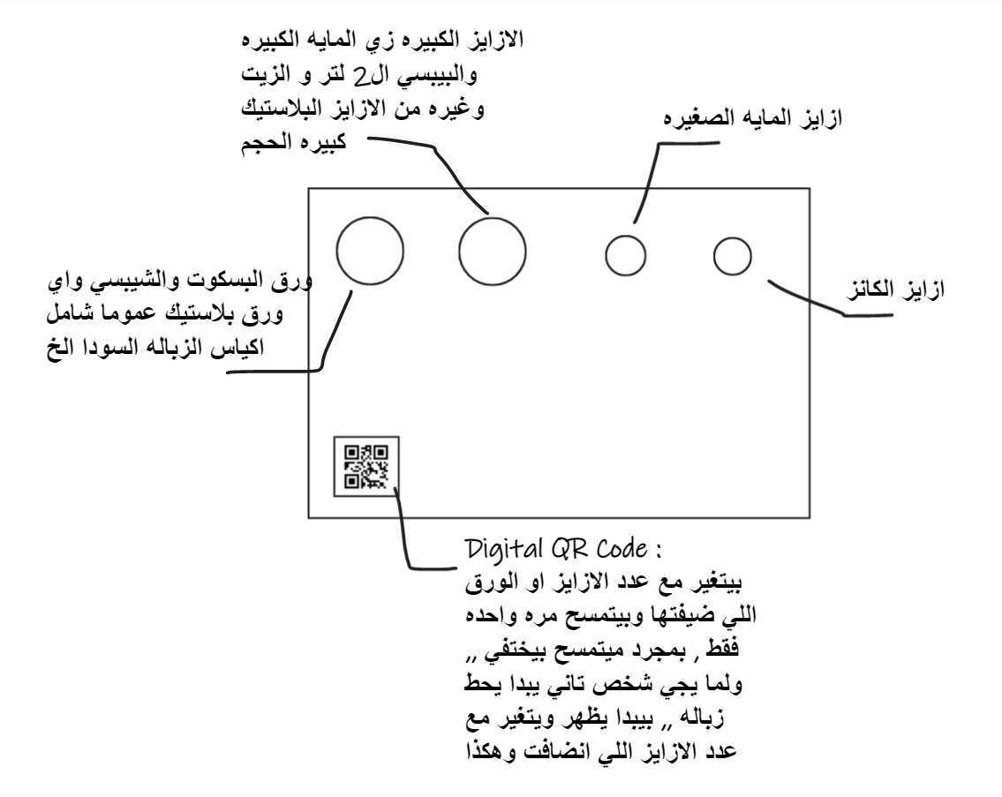
4/ System UI :
First we will talk about Machine View :
This diagram show imaginary shape for real machine .

Slide 8
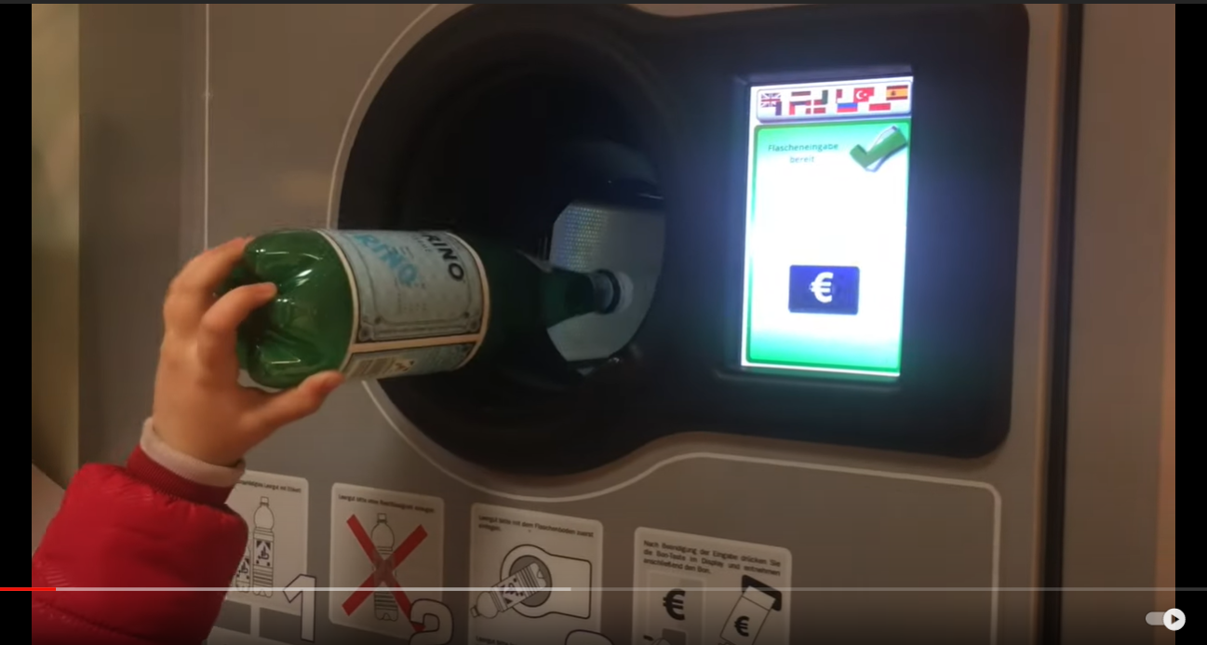
** Example for Real smart garbage collecting machine

Slide 9
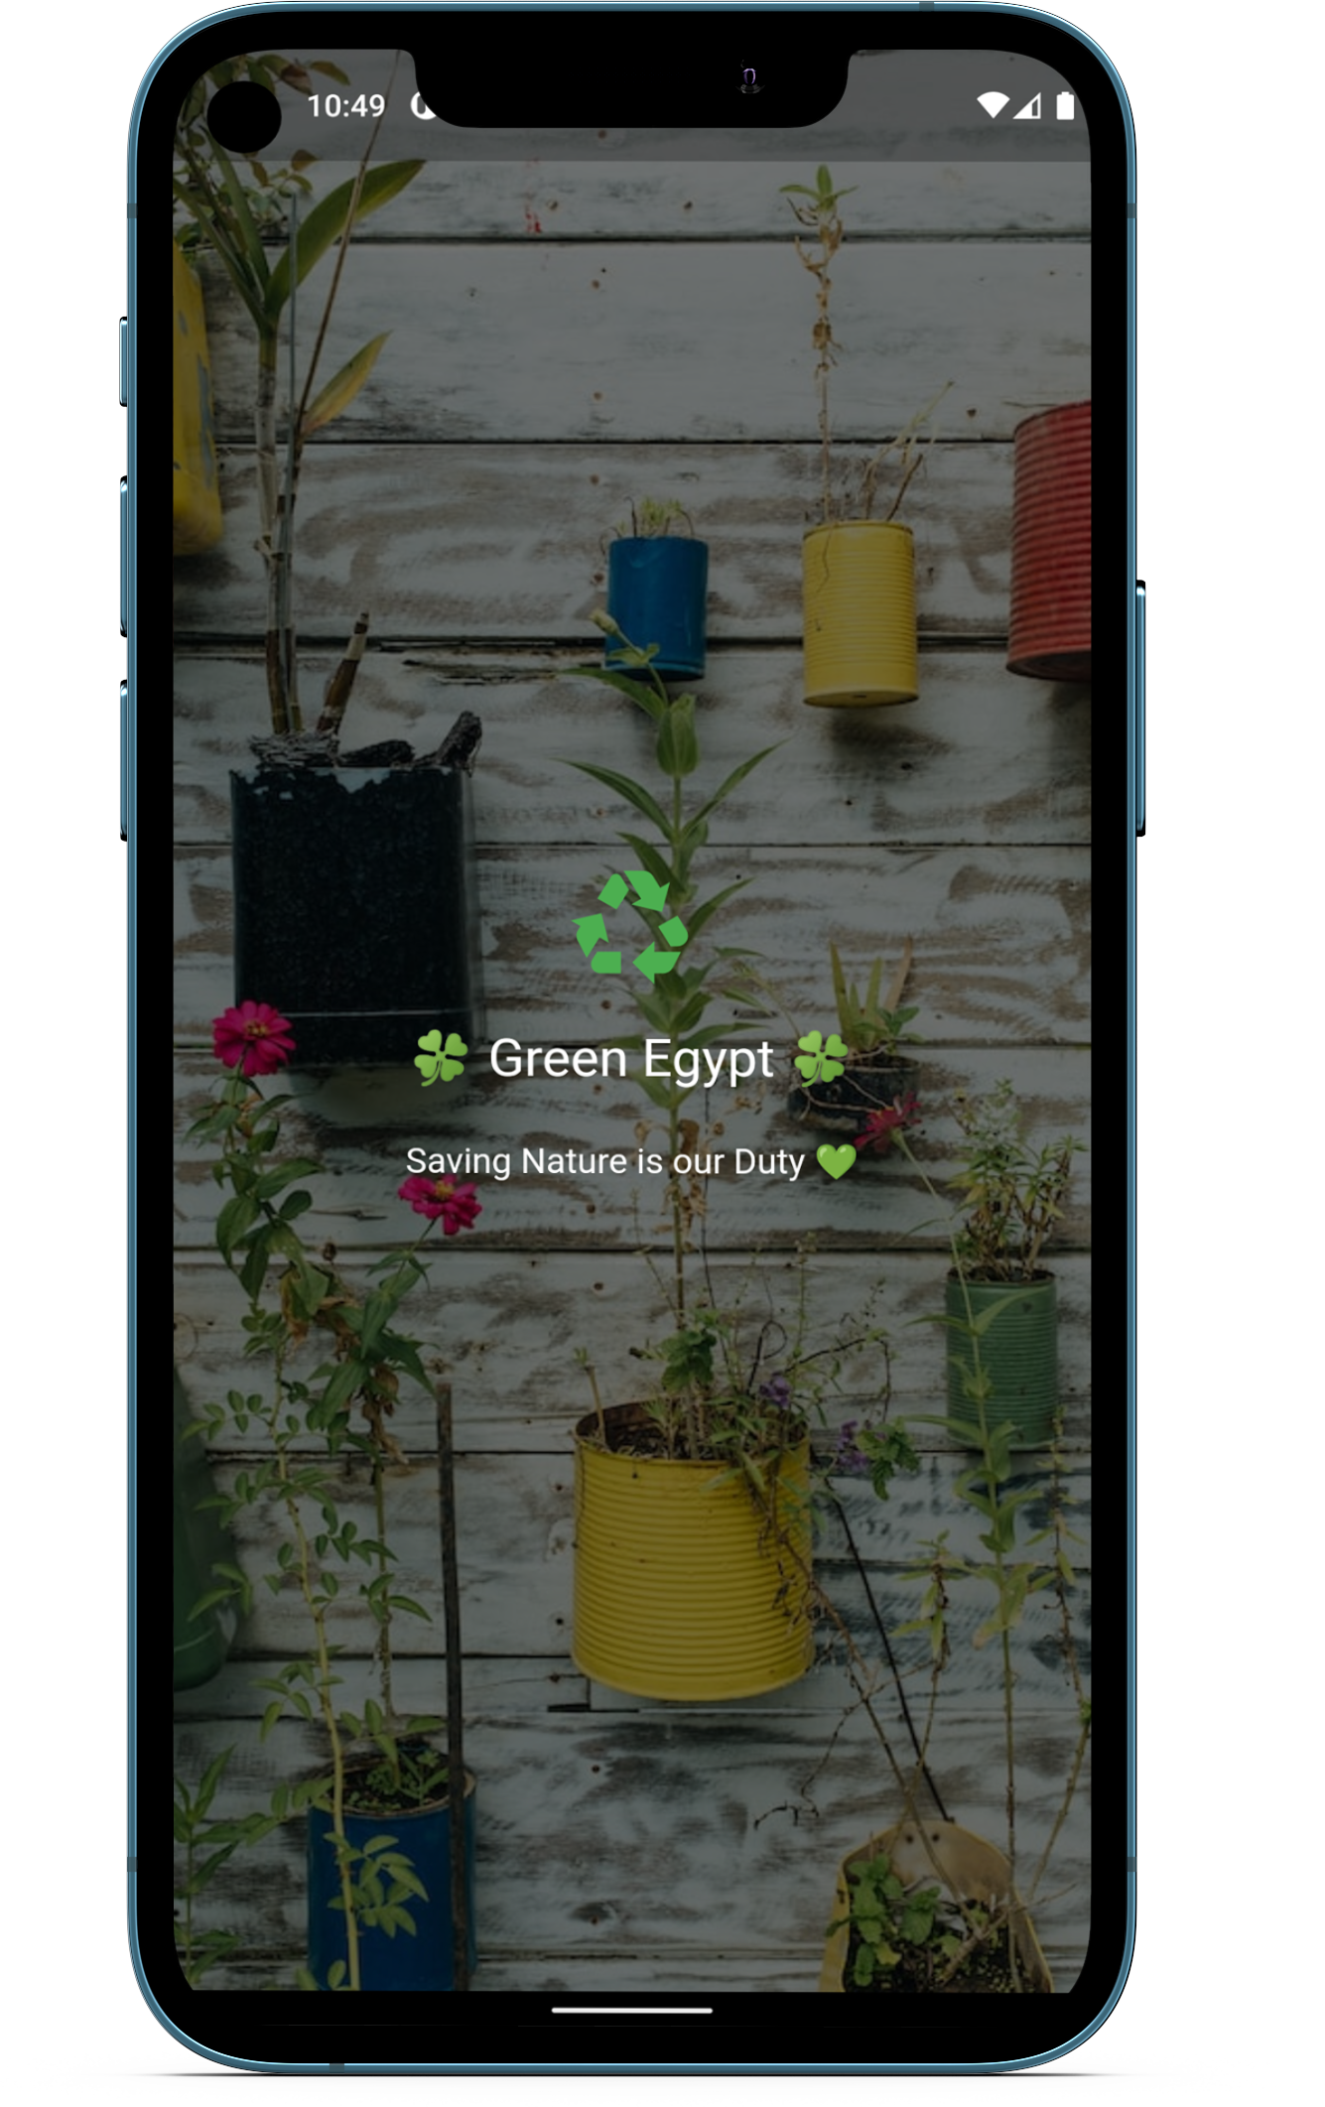
- Application Views :
1. Splash Screen : Screen appear for 1 or 2 seconds then the application Navigate to another screen depending on user state “Logged in or not or First Time open ” .

Slide 10
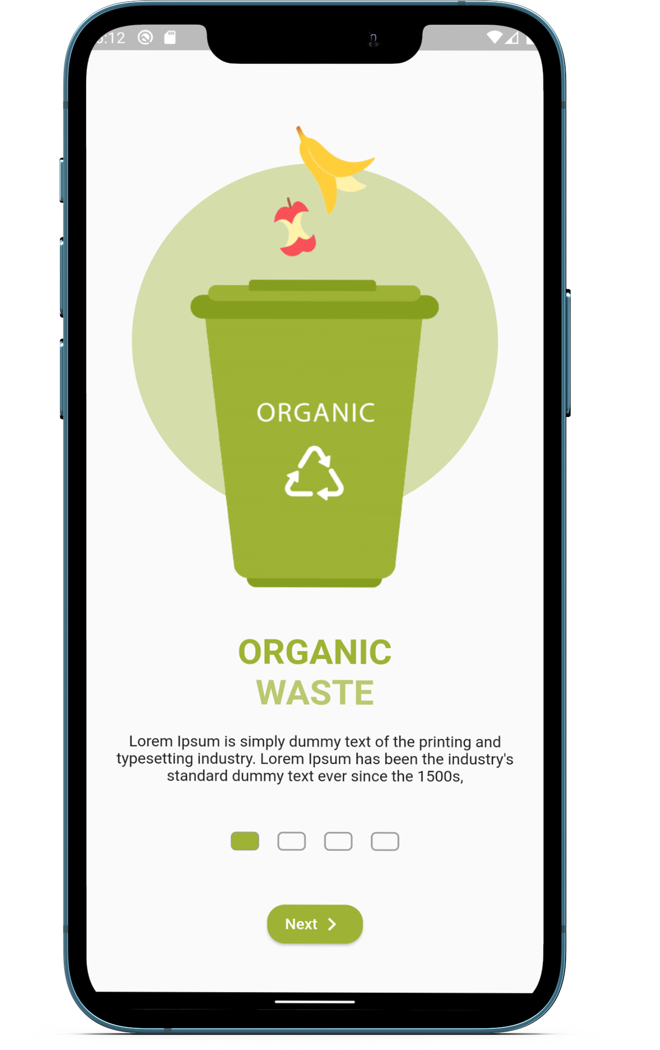
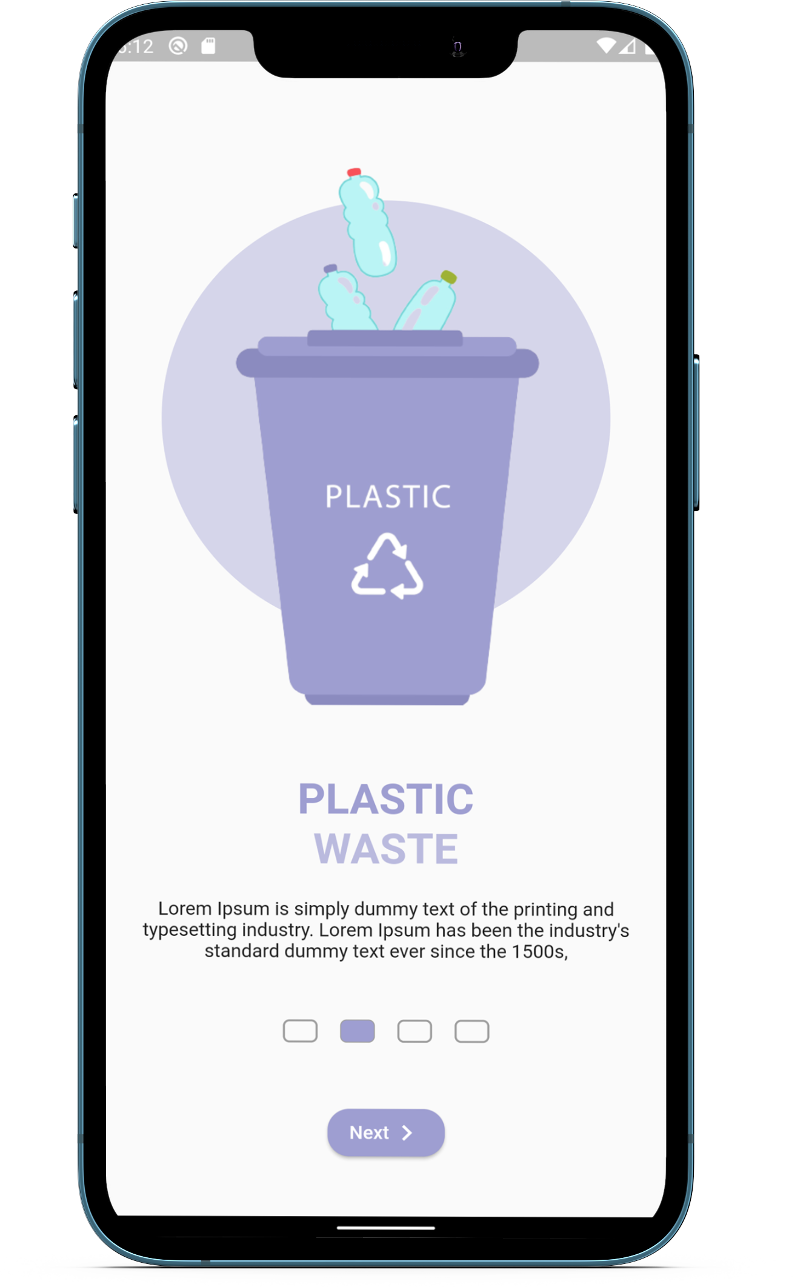
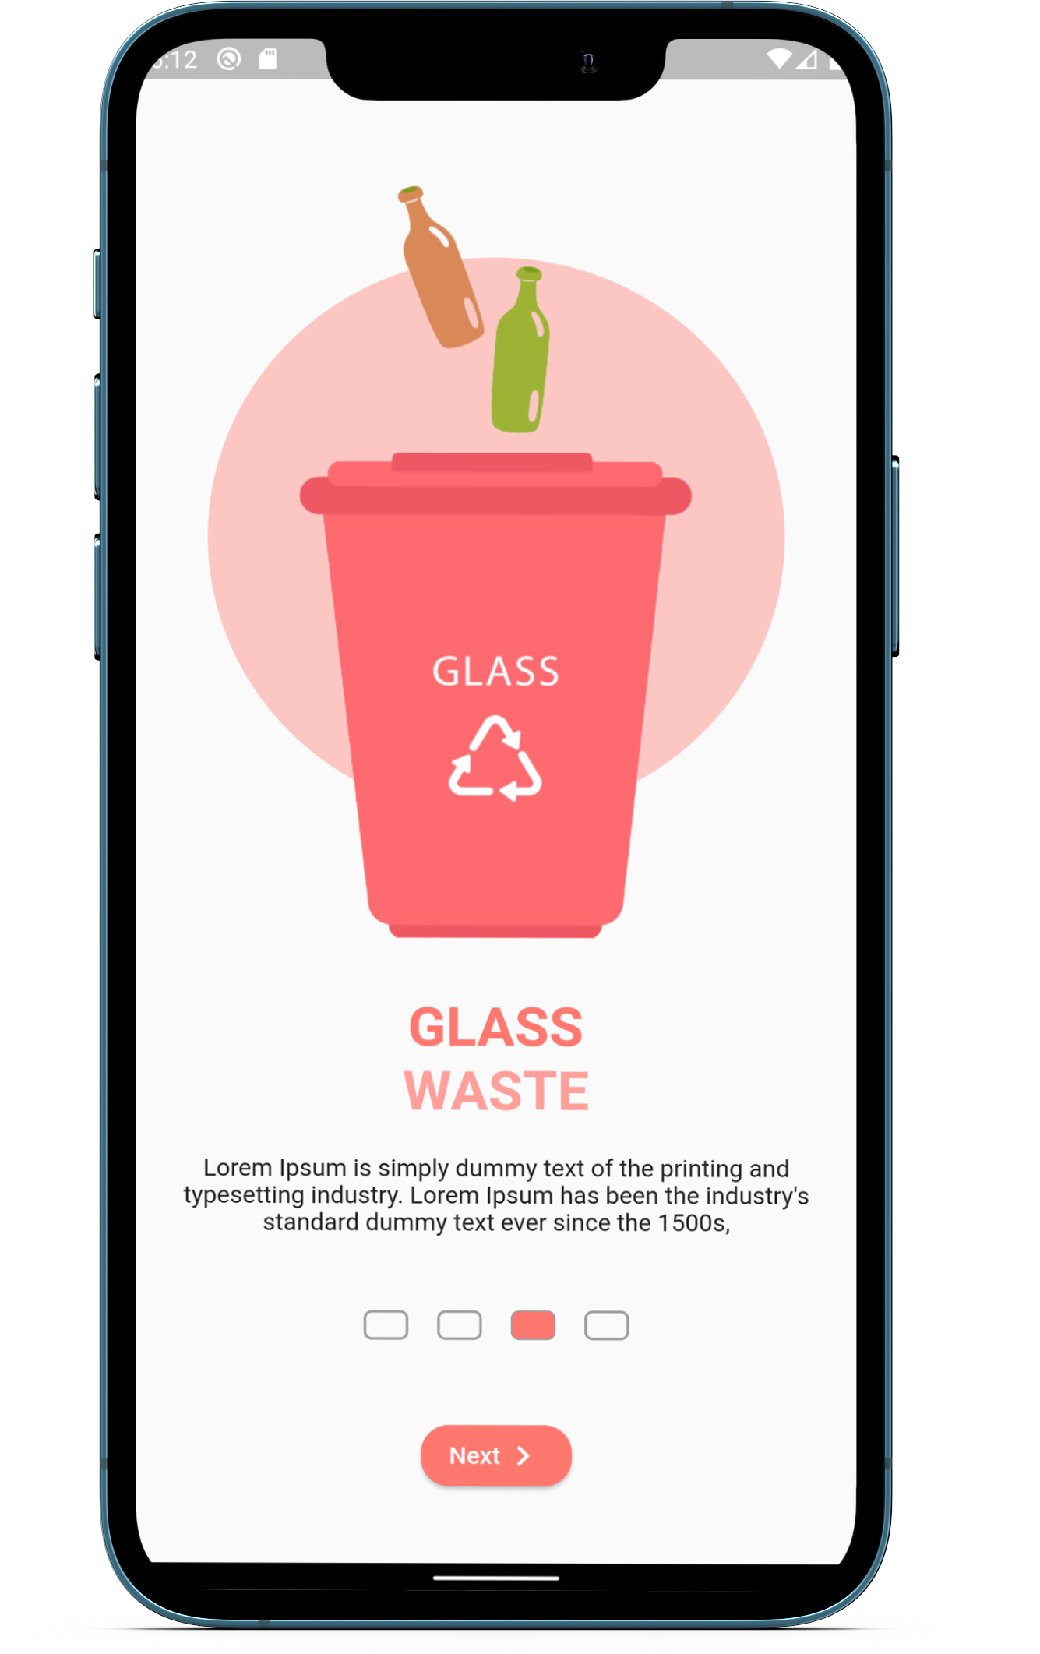
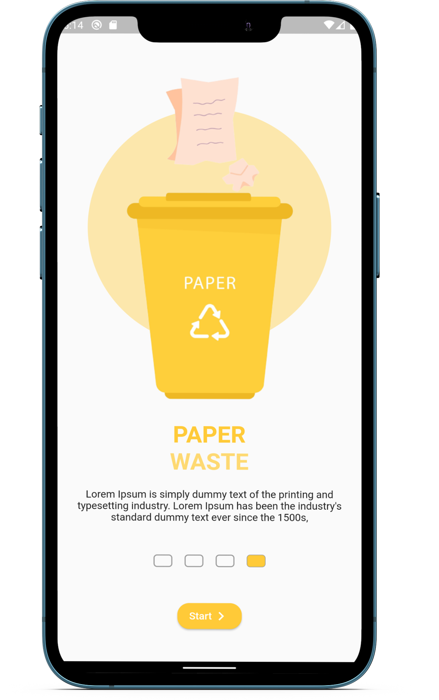
- Application Views :
2. Introduction Screen : Screen that shown first time opening application only .

Slide 11
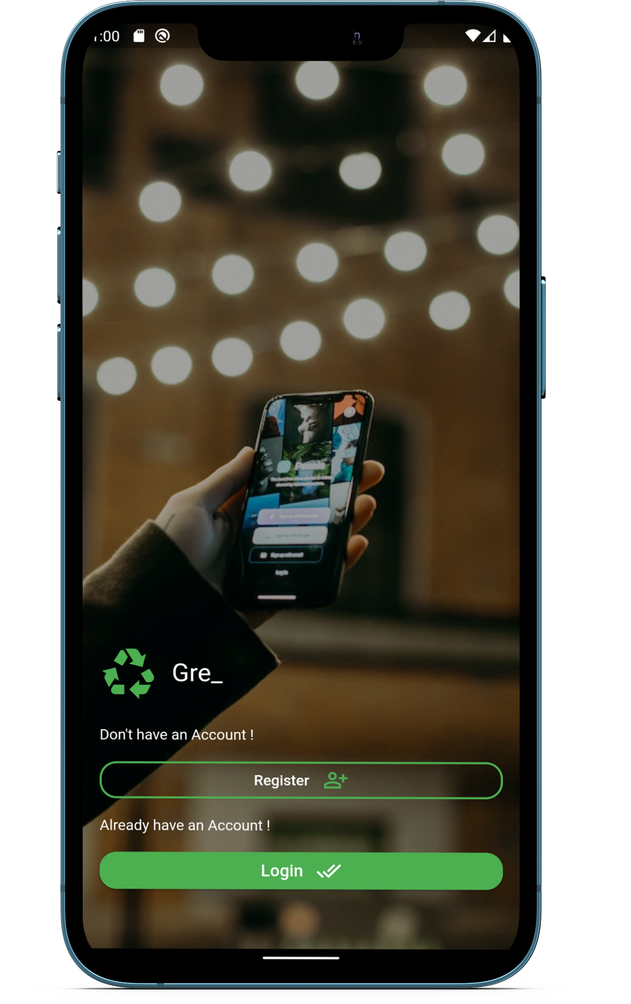
Application Views :
3. Start Screen : Screen appear if user opened the application before , but not logged in :
- User can from it Navigate to Register page or to login page as he like .

Slide 12
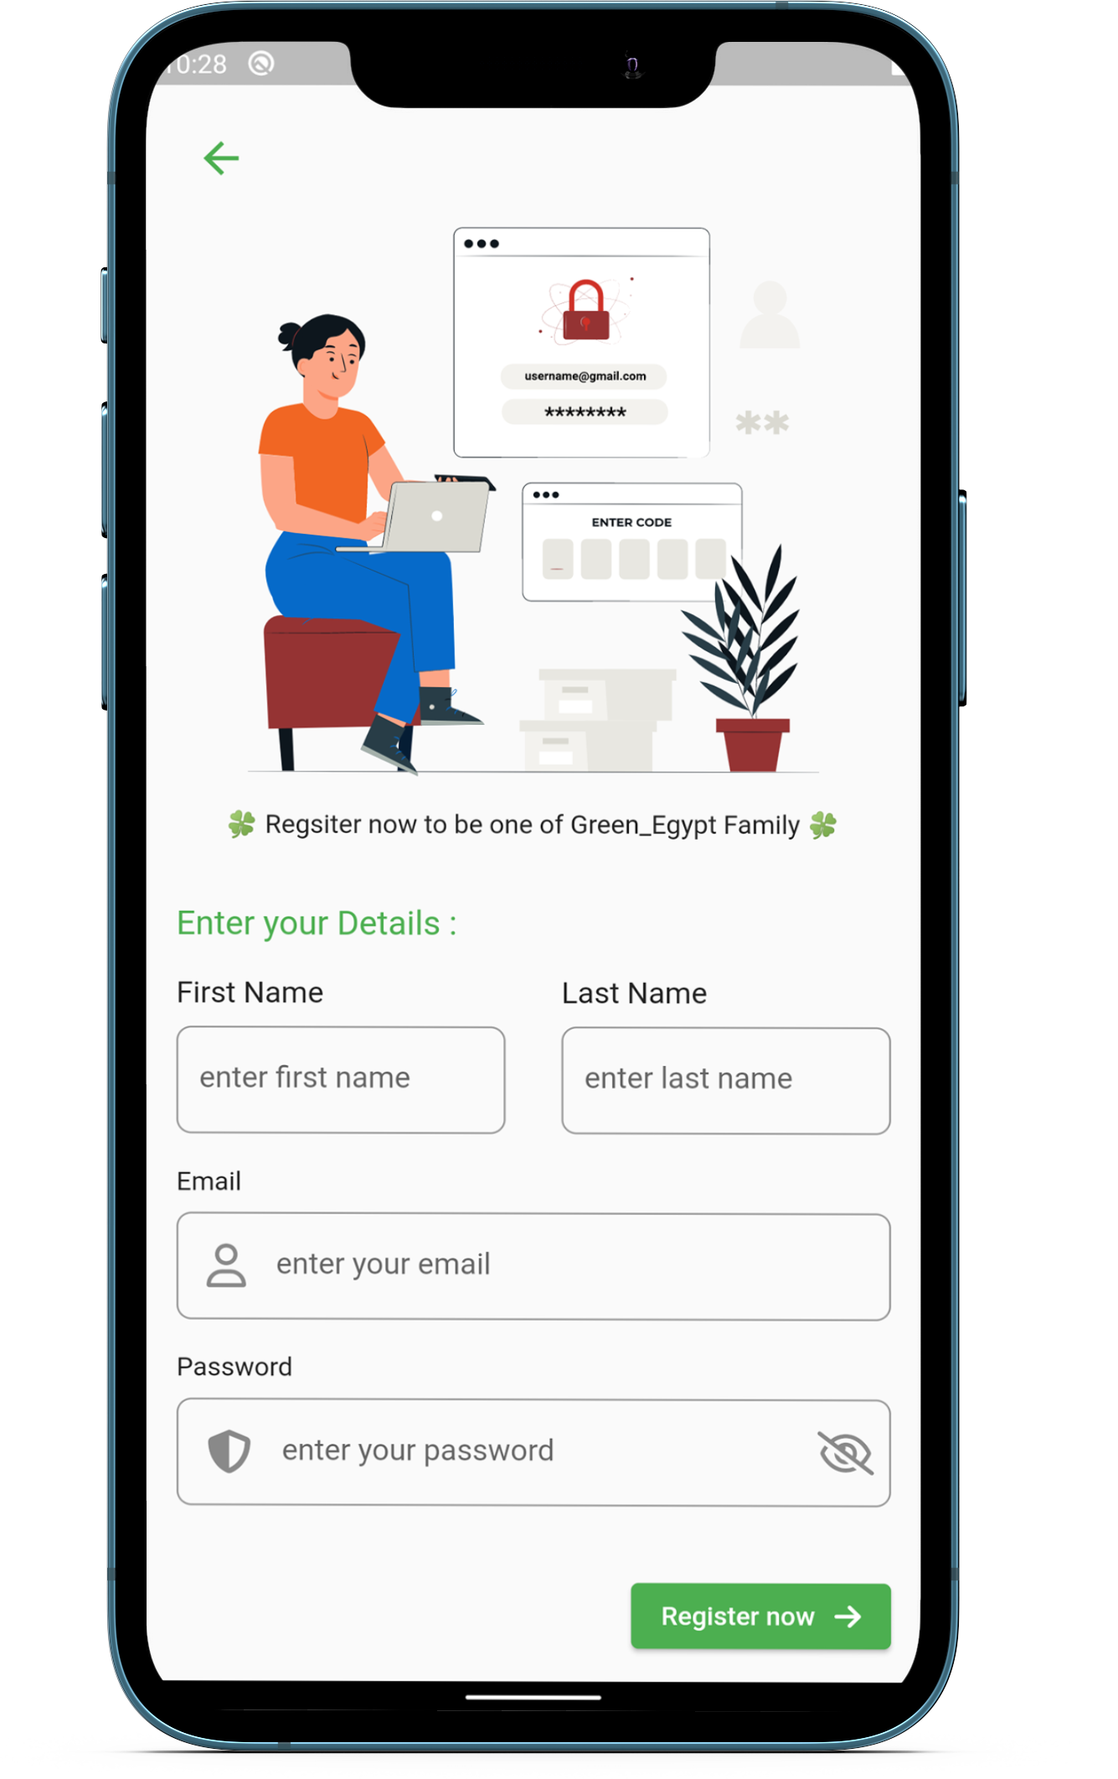
- Application Views :
4. Register Screen : in Register page , user can register with his :
First name .
Last name .
Email .
Password .

Slide 13
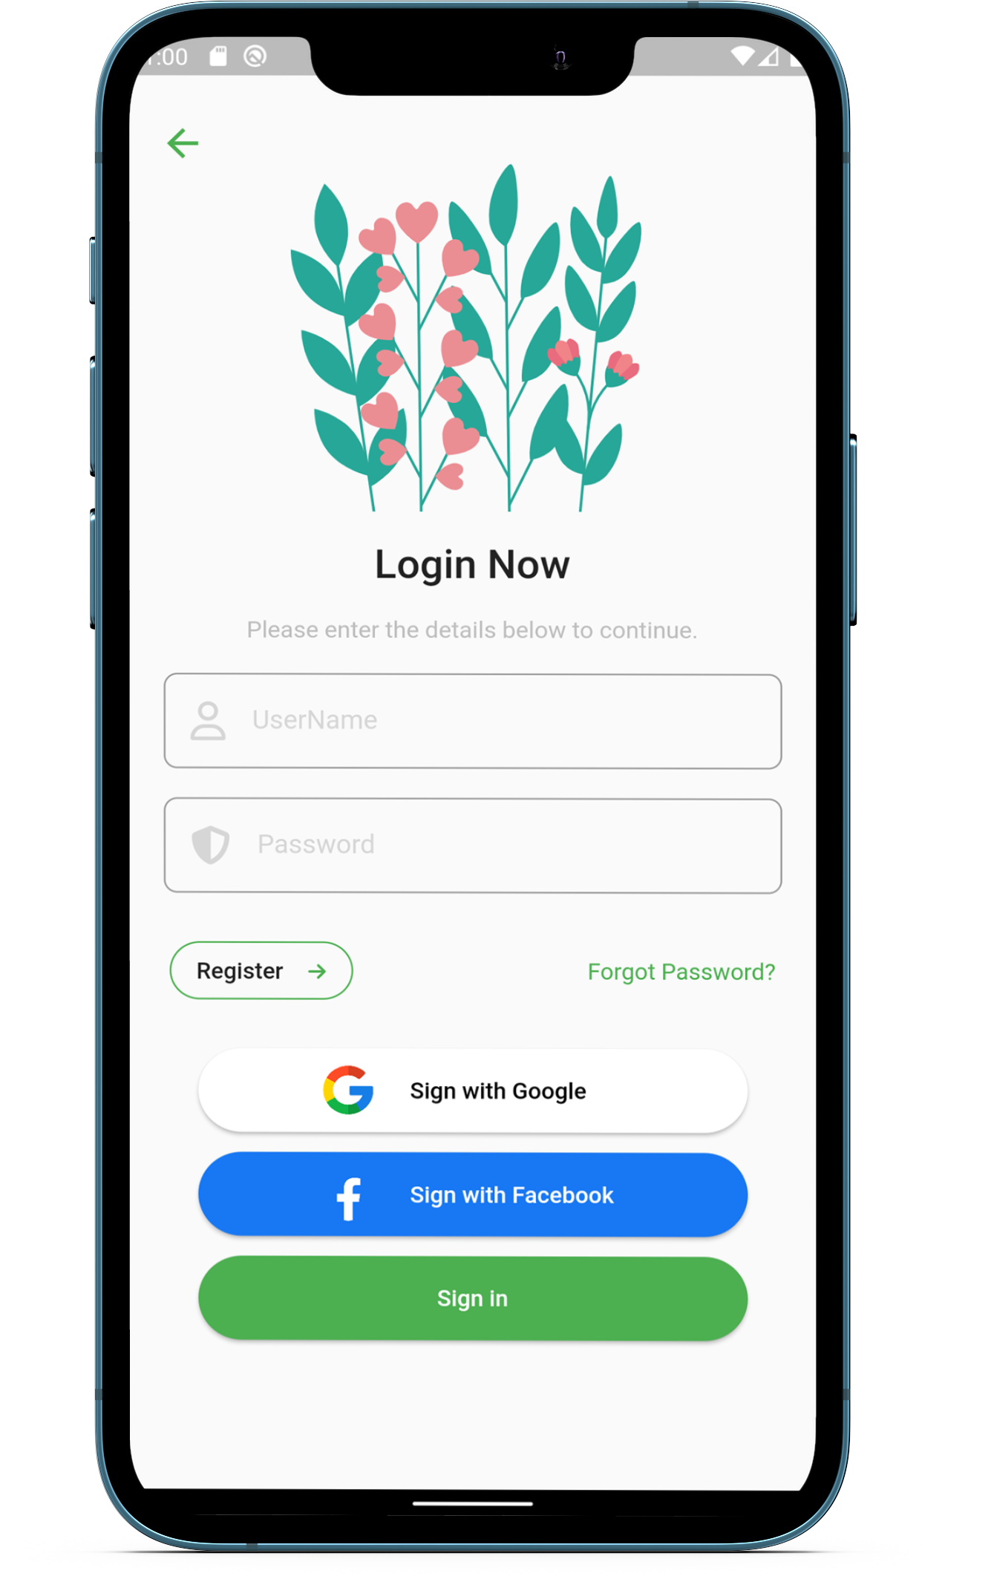
- Application Views :
5. Login Screen : Screen that user can Login with :
1- Custom email and password .
2. Login with Facebook .
3. Login with Google .

Slide 14
Resources :
** Application repo :
https://github.com/MavicaSoftwareDev/Green_Egypt
** Application last release Drive : https://drive.google.com/drive/folders/1RBIem5spzrRUzJ1IpxAhrLRmqIC-ueSJ?usp=sharing ** Application Docs :
https://tech-mavica.notion.site/Green-Egypt-Docs-73034b5905e444c2ae85761ff20a4d6f

